Slide 1


Slide 2
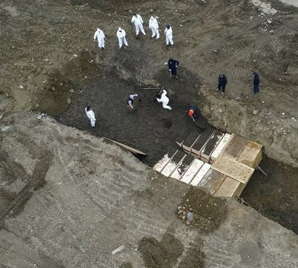
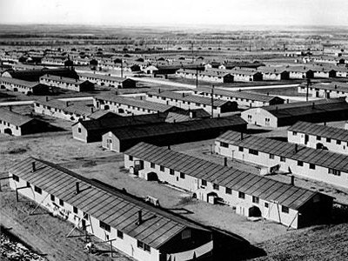
Interment or Internment?
NYC 2020

Slide 3
Beliefs, rituals and funerary practices? Define and explain.

Slide 4
The black text is straight from the task sheet.
To complete this investigation you must:
identify, locate and organise a total of 4-6 relevant sources that relate to the beliefs, rituals and funerary practices of your chosen civilisation (both primary and secondary sources and demonstrate different perspectives)
What should your sources have in common?
Note that funerary practices = only one possible link between your sources.
You can delve into beliefs generally, or perhaps rituals might be your key focus
Sticking to ONE aspect of their belief/religious systems can make it easier – funerary for example. Most students wisely choose to hone in on funerary beliefs and practices.
e.g. 4-5 Celtic rituals revealing their beliefs about and attitudes to birth, marriage and death
e.g. 4-5 sources related to Spartan rituals: 1 funerary, 2 diff perspectives on the role of the Kyrpteia, 2 RE infanticide. Do you see what I mean?

Slide 5
From the task sheet, continued…
devise a key inquiry question and 3-5 sub-questions to help drive your research
The FIA2 no longer requires a Rationale
create a rationale (with a paragraph structure) that explains the thinking behind your topic, e.g. topic choice, origins of questions, possible hypothesis, choice of sources (200 – 300 words) →

Slide 6
→
develop 4-6 source analyses where emphasis is given to analysing the origin, purpose and context of historical evidence, and evaluate historical sources and evidence to show understanding of perspectives and interpretations (800 – 1000 words
This can be in dot point form – I would prefer not (reason:
building skills for the FIA3) but this is your choice.
Note: Your Critical Summary cannot be presented in dot-points.
create a critical summary of evidence reflecting on: the decisions, judgments and/or conclusions that have been made (200 – 300 words)
include a referencing system to acknowledge sources (including a reference list) – APA 7.

Slide 7
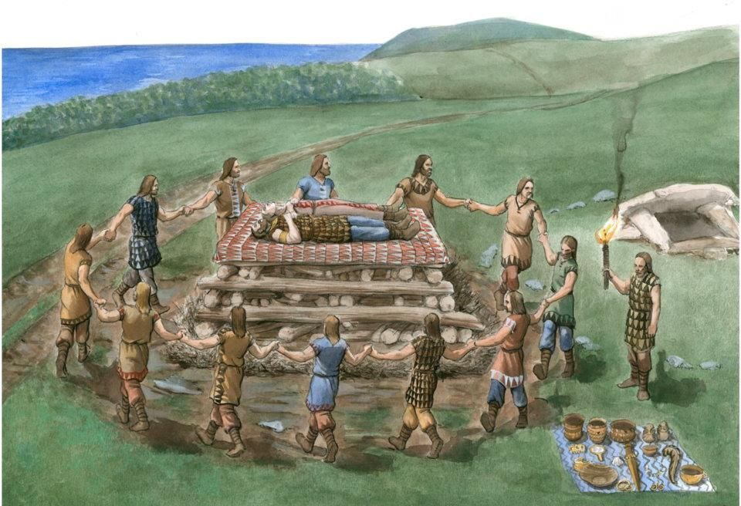
BACKGROUNDING YOUR FIA2

Slide 8
When you analyse evidence from historical sources to show understanding, you need to identify the features, which may include origin, motive, audience, perspective, context, and explicit and implicit meanings.
Use this information to breakdown, examine and interpret the features of the sources.
Let’s look at THE PROCESS before dissecting a source together→

Slide 9
1. Naturally, you begin with general, background reading - Familiarise yourself with the general topic and its vocabulary (You are answering ‘definitions’ questions, basically – See next slide)
Ask yourself, what basic info do I need at this point? key words, names of people, names of eras/periods and the time frame geographical constraints the key concepts need defining – e.g.’viking’, ‘Vahöll, ‘Odin’, ‘Valkyries’ Choose one of two ‘cultures’ provided by your teacher. You have 8 minutes to conduct some general research on that one. Feed back your ‘basic’ learnings, facts…Who were they? Key features. Where were they settled? etc.
Who?
What?
When?
Where?

Slide 10
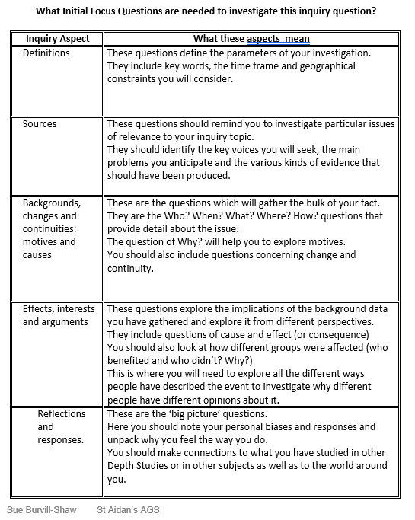
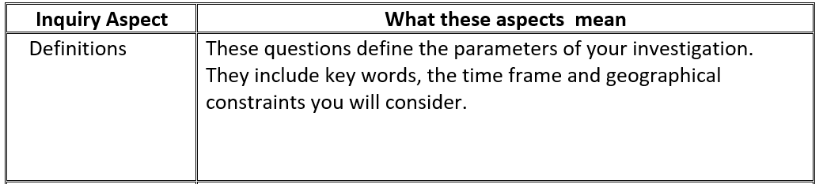

Slide 11
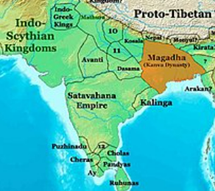
Keep notes – At the very least, gather some understanding of the very ‘basics’ – Here is an example of gathering the basics based on the Mauryan civilisation:
Time and geog. Parameters. They were an Iron Age power centred on Magadha, founded by Chandragupta Maurya – he and mentor, Chanakya, a Hindu Brahman who wrote the Arthashastra, built one of the largest empires on the subcontinent. Jain sources (which ones?) attest that he renounced his empire and became a Jain monk.
Personalities. Apparently, when very young, Maurya met Alexander the Great!
Main Sources - Greek, Hindu, Buddhist and Jain texts. A quick googling reveals that he/they are mentioned in Hellenistic (4thC BCE) Megasthenes’ Indica and in the writings of Arrian of Nicomedia
In Greek and Latin works Maurya is referred to as Sandrokottos or Androcottus.
Belief systems of the period - Buddhism, Jainism and Ajivika gained prominence along with the Brahmanism traditions.
… etcetera You will very gradually delve into some nitty gritty regarding beliefs and rituals….

Slide 12
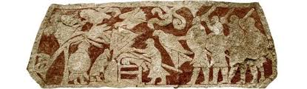

Backgrounding continued Keep/make a Glossary and collect sources as you go! – VIKINGS example
This scene carved onto a picture stone can be interpreted as a blót (sacrifice) to Odin. In the middle a person is apparently being sacrificed on an altar. A large bird of prey, possibly one of Odin’s ravens, hovers above. To the left another person has a noose around their neck and is hanging from a tree. Gotlandic picture stone from Stora Hammars I, in Lärbro parish, Sweden.
Blót– sacrifice
Odin
forn sidr -
nýr sidr -
Pagan -
Gamla Uppsala –
Seid –
Divination -
etc…
https://en.natmus.dk/historical-knowledge/denmark/prehistoric-period-until-1050-ad/the-viking-age/religion-magic-death-and-rituals/human-sacrifices/ Don’t just keep the URL. Save stress later, and immediately create your APA7 reference. <We’ll show you how, now.

Slide 13
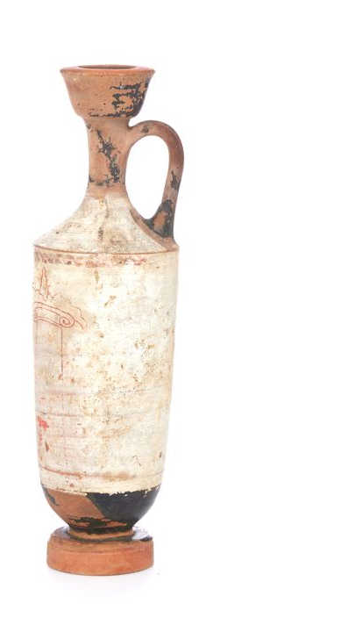
Glossary - focus on Athenians in the Archaic period
lekythos (oil flask)
funerary stele
terracotta krater
kouros (youth)
Hades, Zeus, Poseidon
The ‘psyche’
1- prothesis (laying out of the body)
2- ekphora (funeral procession)
3- Lamentation of the Dead
etcetera…

